Slide 1

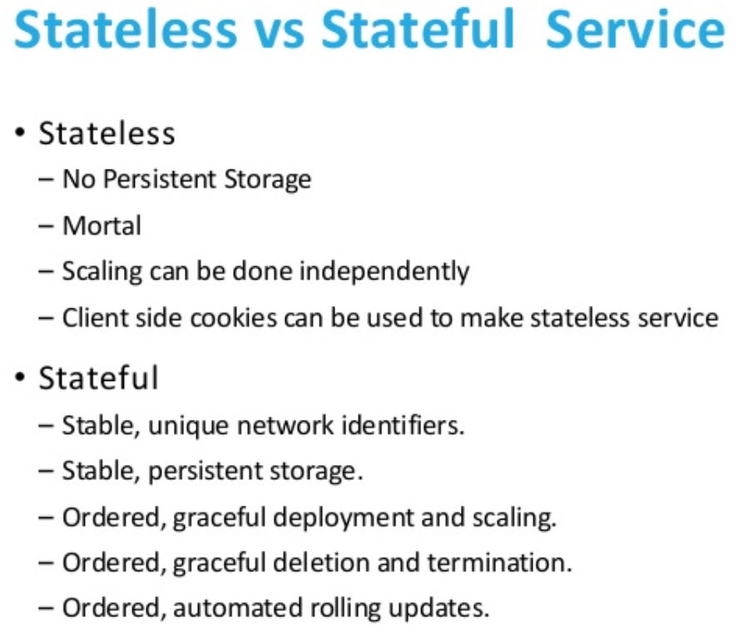
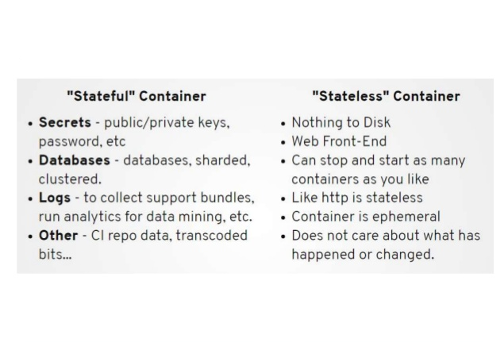

Slide 2
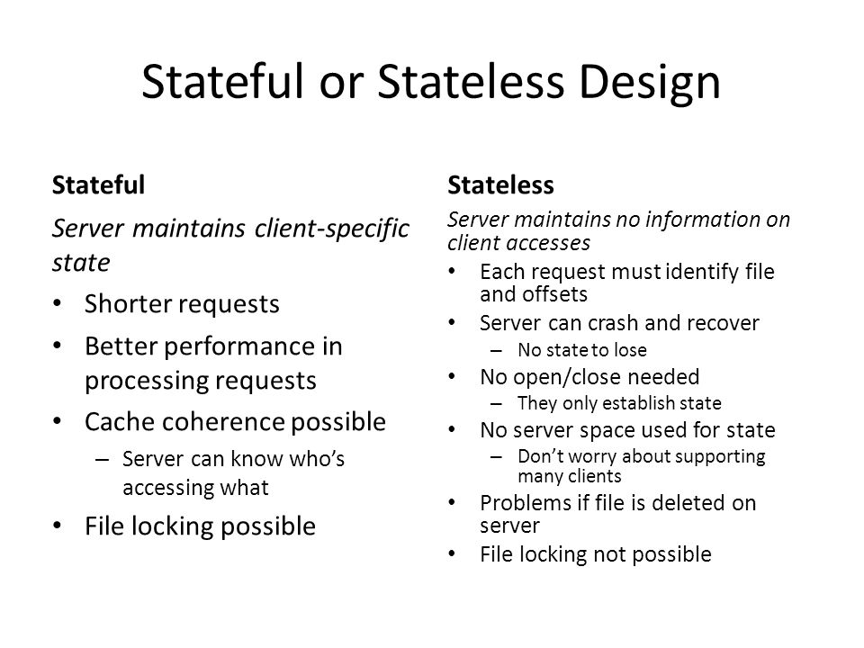

Slide 3
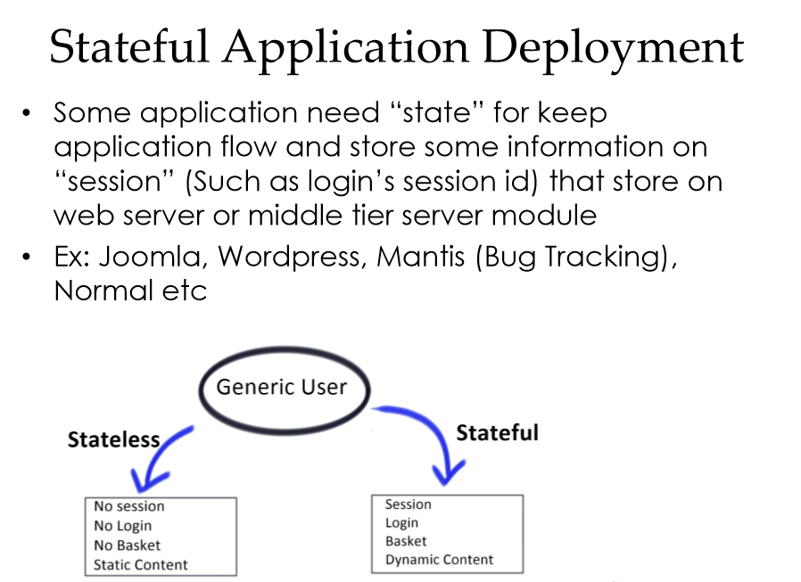

Slide 4
StatefulApplication Deployment
Kubernetes: Production Workload Orchestration
Considering o Original “HTTP” protocol is “stateless” o Stateful application need to keep session by web/app server and keep “cookies” on client for pass authentication o Work on memory for keep session (Fast/Easy but consume resource) o Many problem with native mobile app/Centralize Problem o Scale will effect for consideration traffic redirect to correct server (Keep state)
Awareness o Container is naturally design for “stateless” application o All load-balance/dispatch job is not aware about “state” of application inside

Slide 5
StatefulApplication Deployment
Kubernetes: Production Workload Orchestration Solution ?
SDS (Software-Defined Storage) for make centralize storage pool
Share centralize storage pool for all node
For Web/App Server
Keep application path / Session path on storage pool
Every server will read/write on same place
For Database Server Many option for operate (depend on type of database)
Active/Active
Active/Hot-Passive
Active/Cold-Passive
Postgres Kubedb Tool (Beta)
Idea also keep data on storage pool

Slide 6
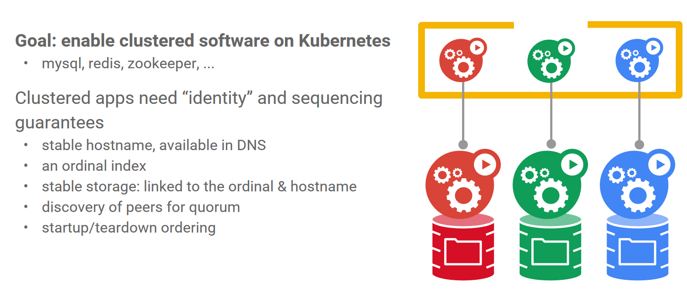

Slide 7
Demo

Slide 8


